Slide 1
Queues
Chapter 8
Notes:
1

Slide 2
Chapter Contents
Introduction
Linear (Array) Queue Implementation
Linked Queue Implementation
Queue Implementation: Derived Class

Slide 3
Objective
Learn how to implement a queue as a derived class

Slide 4
Queues are Restricted Linked Lists
Recall that the queue data structure allows elements to be added to the queue only at one end and be removed from the queue only at the other end
Thus, a queue can be implemented as a constrained version of a linked list

Slide 5
Using Inheritance
We will take advantage of the close relationship between lists and queues to implement a queue class primarily by reusing a list class
We can implement the queue class through:
public inheritance of the list class
private Inheritance of the list class
Then we implement an identically performing queue class through composition by including a list object as a private member of a queue class

Slide 6
Recall: In public Inheritance
All public members in the base class become public in the derived class and can be accessed directly by member functions, friend functions, and nonmember functions.
All protected members in the base class become protected in the derived class and can be accessed directly by member functions and friend functions.
All private members in the base class are hidden in the derived class and can be accessed by member functions and friend functions through public or protected member functions of the base class.

Slide 7
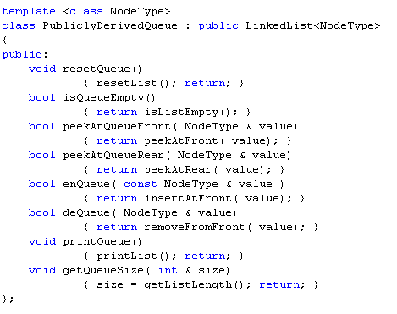
The PublicDerivedQueue Class

Slide 8
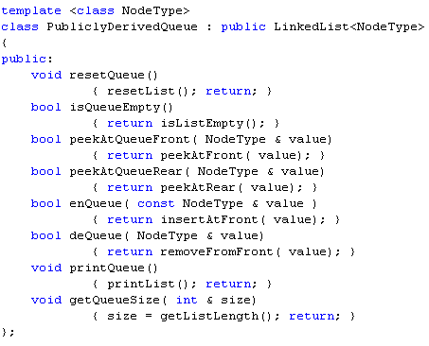
The PublicDerivedQueue Class
Queue member functions are essentially the same as certain list class member functions
So, each queue member function is implemented through a function call to the correspondent list member function

Slide 9
Public Items are Public and Can be Accessed by None-Member Functions
Of course, the list class contains other member functions that we would NOT want to make accessible through the public interface of the queue class
Public inheritance does not prevent such access!

Slide 10
Recall: In private Inheritance
All public and protected members in the base class become private in the derived class and can be accessed directly only by member functions and friend functions.
All private members in the base class are hidden in the derived class and can be accessed by member functions and friend functions through public or protected member functions of the base class.
Hence, private inheritance disallows illegal operations on queues

Slide 11
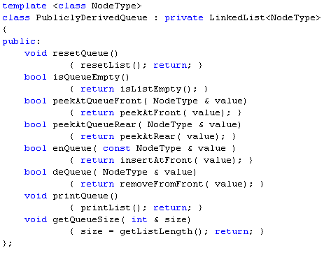
The PrivatelyDerivedQueue Class

Slide 12
Public Items are Private and Cannot be Accessed by None-Member Functions

Slide 13
Private Inheritance Prevents Illegal Operations on Queues!

Slide 14
No Illegal Operations!

Slide 15
Queue Class Through Composition
Include a list object as a private data member
Call appropriate member functions through this list object

Slide 16
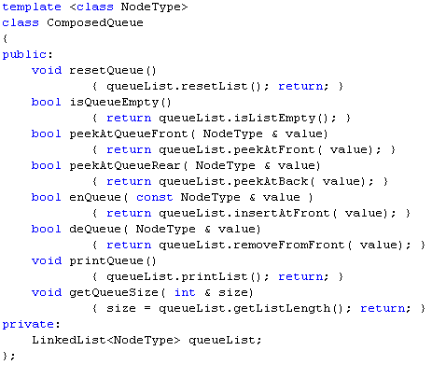
The ComposedQueue Class

Slide 17
Testing the ComposedQueue Class

Slide 18
Section 4 and Chapter 8 - End

